Slide 1

Hate Incidents in Schools
A presentation for teachers and school staff around the dealing of Hate Incidents which occur within school premises
Notes:
Welcome to this short guide to dealing with hate incidents in schools.

Slide 2



Introduction
In June 2023, an updated Code of Practice* came into force relating to the recording of non-crime hate incidents. This affects how hate incidents, which do not amount to a crime, that occur in our schools are recorded and reported.
* Non-Crime Hate Incidents Code of Practice on the Recording and Retention of Personal Data, as provided for in the Police, Crime, Sentencing and Courts Act 2022.
Notes:
Since June 2023, schools have been required to deal with non-crime hate incidents that take place on their premises.
Settings should have processes in place to regularly review this data to identify emerging themes and inform preventative and responsive work around hate crime.

Slide 3

Hostility or prejudice because of someone’s:
• disability
• race
• religion
• sexual orientation
• transgender identity
Notes:
This means that…
If you witness or receive a report of hostility or prejudice towards a student or staff because of their:
• disability
• race
• religion
• sexual orientation
• transgender identity
this should be recorded as a hate incident.

Slide 4
What is a hate crime?
Any crime from assault to harassment, in public or in private.
offender has targeted a person
because of a particular characteristic.
Notes:
What is a hate crime?
Hate crimes can take almost any form.
Assaults, harassment or damage to property can all be hate crimes, if the victim was targeted because of their ‘particular characteristic’. They can take place anywhere - in the street, on a bus, at work, at school or online.
What makes it a hate crime is that the offender targeted a person because of a particular characteristic.

Slide 5
Identifiable group of people
A particular characteristic that is protected under hate crime legislation:
Race or perceived race
Religion or perceived religion
Sexual orientation or perceived sexual orientation
Disability or perceived disability
Transgender identity or perceived transgender identity
“Particular Characteristics”
Notes:
In hate crime legislation, particular characteristics are:
• race – race, colour, nationality, including citizenship or ethnic or national origins.
• religion – faith, religious belief or lack of religious belief.
• sexual orientation – or perceived sexual orientation, whether towards people of the same sex, the opposite sex, or both.
disability – be it physical or mental impairment, including learning disability.
• transgender identity – anyone being transgender, transsexual or who has undergone or is in the process of gender reassignment or perceived transgender identity.
Not every crime committed against a person in one of these groups is a hate crime.
If a crime happened, but not because of a person's particular characteristic, in other words their disability, race, religion, etc, then it's not a hate crime.
Interestingly, a crime can be a hate crime if the victim was targeted because it was believed that they were from a protected group, even if they’re not. For example, if someone verbally abused you because they thought you are gay, when in fact you are not, then you may also be a victim of a hate crime.

Slide 6
What is a hate incident?
Hostility
Prejudice
against an identifiable group of people
Hate
It's all about the motivation surrounding a perpetrator's actions which makes it “hate” related.
Notes:
What is a 'hate incident’?
If an incident occurs that is believed to be motivated by hostility or prejudice, but a crime has not occurred – this is a ‘hate incident’.
In school, an example could be someone refusing to work with another pupil because they are from a specific national background.
Let's look at some other examples:

Slide 7
What is a hate incident?
Tom cycles to school. Every day in the school cycle store, a group of youths who regularly make fun of people with disabilities spit at him and push him whilst throwing insults. Tom is partially deaf and has a speech impediment.
.
There has been an ongoing dispute between two pupils. During an argument, one pupil has been heard to say “go back to your own country, we don’t need you here”.
“Hate Incident”
“Hate Crime”
Notes:
There's been an ongoing dispute between two pupils.
During an argument, one pupil has been heard to say: “Go back to your own country, we don't need you here.”
Is this a hate crime or hate incident?
It’s a hate incident – based on race.
Another student, Tom, cycles to school. Every day in the school cycle store, a group of youths who regularly make fun of people with disabilities spit at him and push him whilst throwing insults.
Tom is partially deaf and has a speech impediment.
Is this a hate crime or hate incident?
It’s a hate crime – based on disability.

Slide 8
“I was just leaving the canteen and Sophie looked me up and down and said, “your sort disgust me”.​”
Notes:
Mrs Smith is about to begin her afternoon lesson when Sam reports an incident to her. Sam says: “I was just leaving the canteen and Sophie looked me up and down and said, ‘Your sort disgust me’.”
Sam's clearly distressed by this comment.

Slide 9
Is this a Hate Incident or Hate Crime or neither?
It’s a hate incident
Notes:
Is this a hate incident or hate crime or neither?
It’s a hate incident – based on prejudice towards Sam's perceived sexual orientation.

Slide 10
Incidents in schools
The code has placed emphasis on schools to investigate and manage non-crime hate incidents which occur on school premises:
Non-crime incidents involving school-aged children, where the alleged behaviour takes place on school premises, should be referred to the school’s management team to assess the risk and decide on a proportionate response.
This includes incidents in a classroom during a lesson, or in the playground. It may also include incidents involving school staff. It does not apply to incidents during school trips or on school transport to and from school.
Notes:
Non-crime hate incidents involving school-aged children where the alleged behaviour takes place on school premises should be referred to the school's management team to assess the risk and decide on a proportionate response.
• This includes incidents in a classroom, during a lesson or in the playground.
• It may also include incidents involving school staff.
• It does not apply to incidents during school trips or on school transport to and from school.
The school management team should implement appropriate safeguarding measures for any children involved.
• Where appropriate, the school should ensure that a parent or guardian is notified and present when a child may be questioned.
• If there is suggestion that the school may not be able to adequately address the concern or there is a risk that the incident may escalate further or result in criminal conduct either within or outside school, this may warrant further police involvement.

Slide 11
Incidents in schools
The school management team should implement appropriate safeguarding measures for any children involved. ​
Where appropriate, school should ensure that a parent or guardian is notified and present when a child may be questioned.​
If there is suggestion that the school may not to be able to adequately address the concern, or there is a risk that the incident may escalate further or result in criminal conduct (either within or outside the school), this may warrant further police involvement.
Notes:
Non-crime hate incidents involving school-aged children where the alleged behaviour takes place on school premises should be referred to the school's management team to assess the risk and decide on a proportionate response.
• This includes incidents in a classroom, during a lesson or in the playground.
• It may also include incidents involving school staff.
• It does not apply to incidents during school trips or on school transport to and from school.
The school management team should implement appropriate safeguarding measures for any children involved.
• Where appropriate, the school should ensure that a parent or guardian is notified and present when a child may be questioned.
• Police should not generally be involved in dealing with non-crime hate incidents that occur on school premises.
• If there is suggestion that the school may not be able to adequately address the concern or there is a risk that the incident may escalate further or result in criminal conduct either within or outside school, this may warrant further police involvement.

Slide 12



Next steps…
If you feel a hate crime has been committed, please submit a report via www.report-it.org.uk or by calling the police non-emergency number 101. In an emergency always call 999.
Head to the Grid where you will find our schools’ toolkit, which will allow you to deliver hate crime sessions to Key Stages 2, 3 and 4.
Notes:
Next steps.
If you feel a Hate Crime has been committed, please submit a report via www dot report hyphen it dot org dot uk or by calling the police non-emergency number 101 – in an emergency always call 999.
Head to the Grid where you will find our comprehensive schools toolkit, which will allow you to deliver hate crime sessions to key stages 2, 3 and 4.

Slide 13
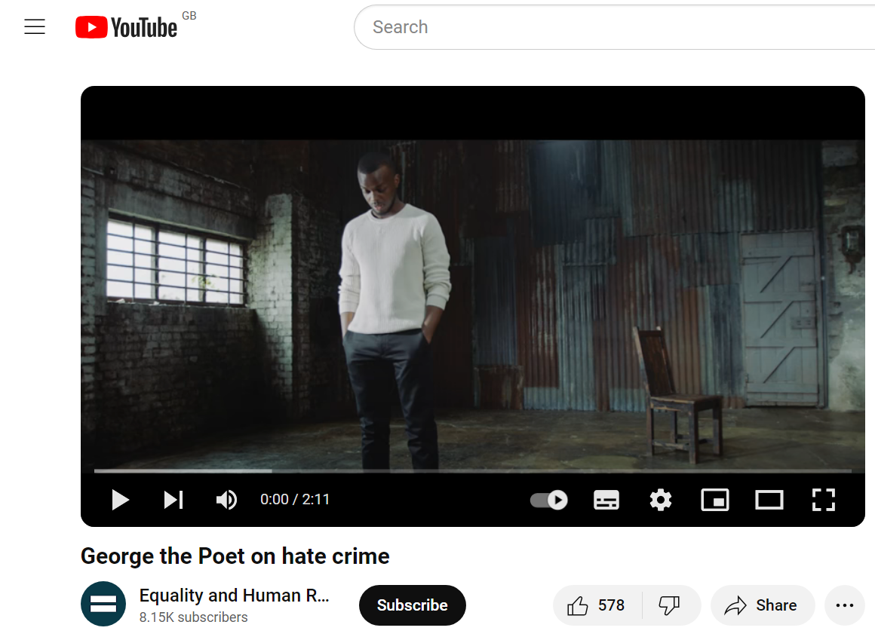
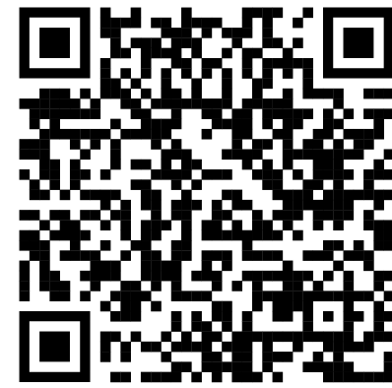
Final thought…
Notes:
As a final thought and reflection on what we have covered, please take the opportunity to scan this QR code and watch this thought-provoking poem where George explores the subject of hate crime before calling on all of us to come together to challenge intolerance wherever we see it and to report incidents of hate.

Slide 14
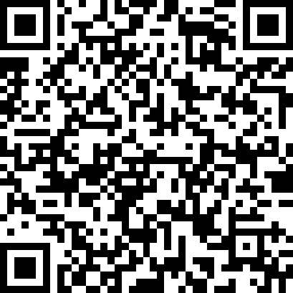
Hate Incidents in Schools
www.hertsagainsthate.org/stopthehate
Notes:
Please visit www dot herts against hate dot org forward slash stop the hate for more information.

